Slide 1
NEW PROJECT LOUNCH
START

Slide 2



Dream Inspire Global
Private Limited.
# Apni Company
Growing
&
Ethical
Business Project

Slide 3
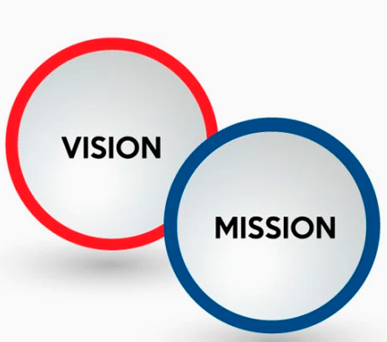
Dream Inspire Global Private Limited.
VISION
MISSION
VALUES
Empowering People to Enhance Their Lifestyle By Helping Them Achieve Their Ambitions & Dreams In Life In Style.
To design and modernise our Direct Selling shopping models with time and to pave a smooth path of success for our distributors. Dream Inspire aims at providing products and services, that fit exceedingly well on the quality barometer and is economical, therein addressing our social responsibility to the society
FARMERS
DISTRIBUTORS
LEADERS
HEALTHY INDIA
EMPLOYEMENT

Slide 4
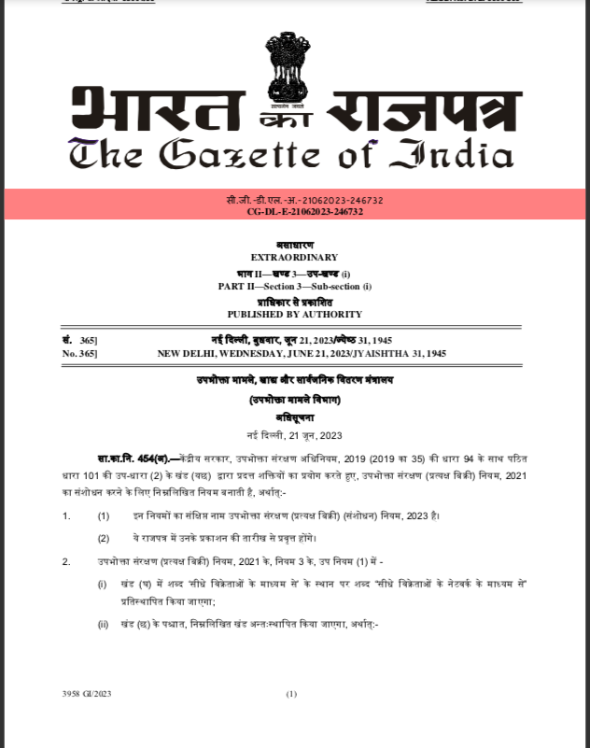

THE GAZETTE
OF INDIA

Slide 5
Dream Inspire Global Private Limited.
Important Key
Realistic Income Plan
High Quality and Result Oriented Product
Ethical , Trusted & 12 yrs Experienced Management
No Hidden Terms Conditions
Instant Payout
As Per Trend , Situation & Futuristic Business Model

Slide 6


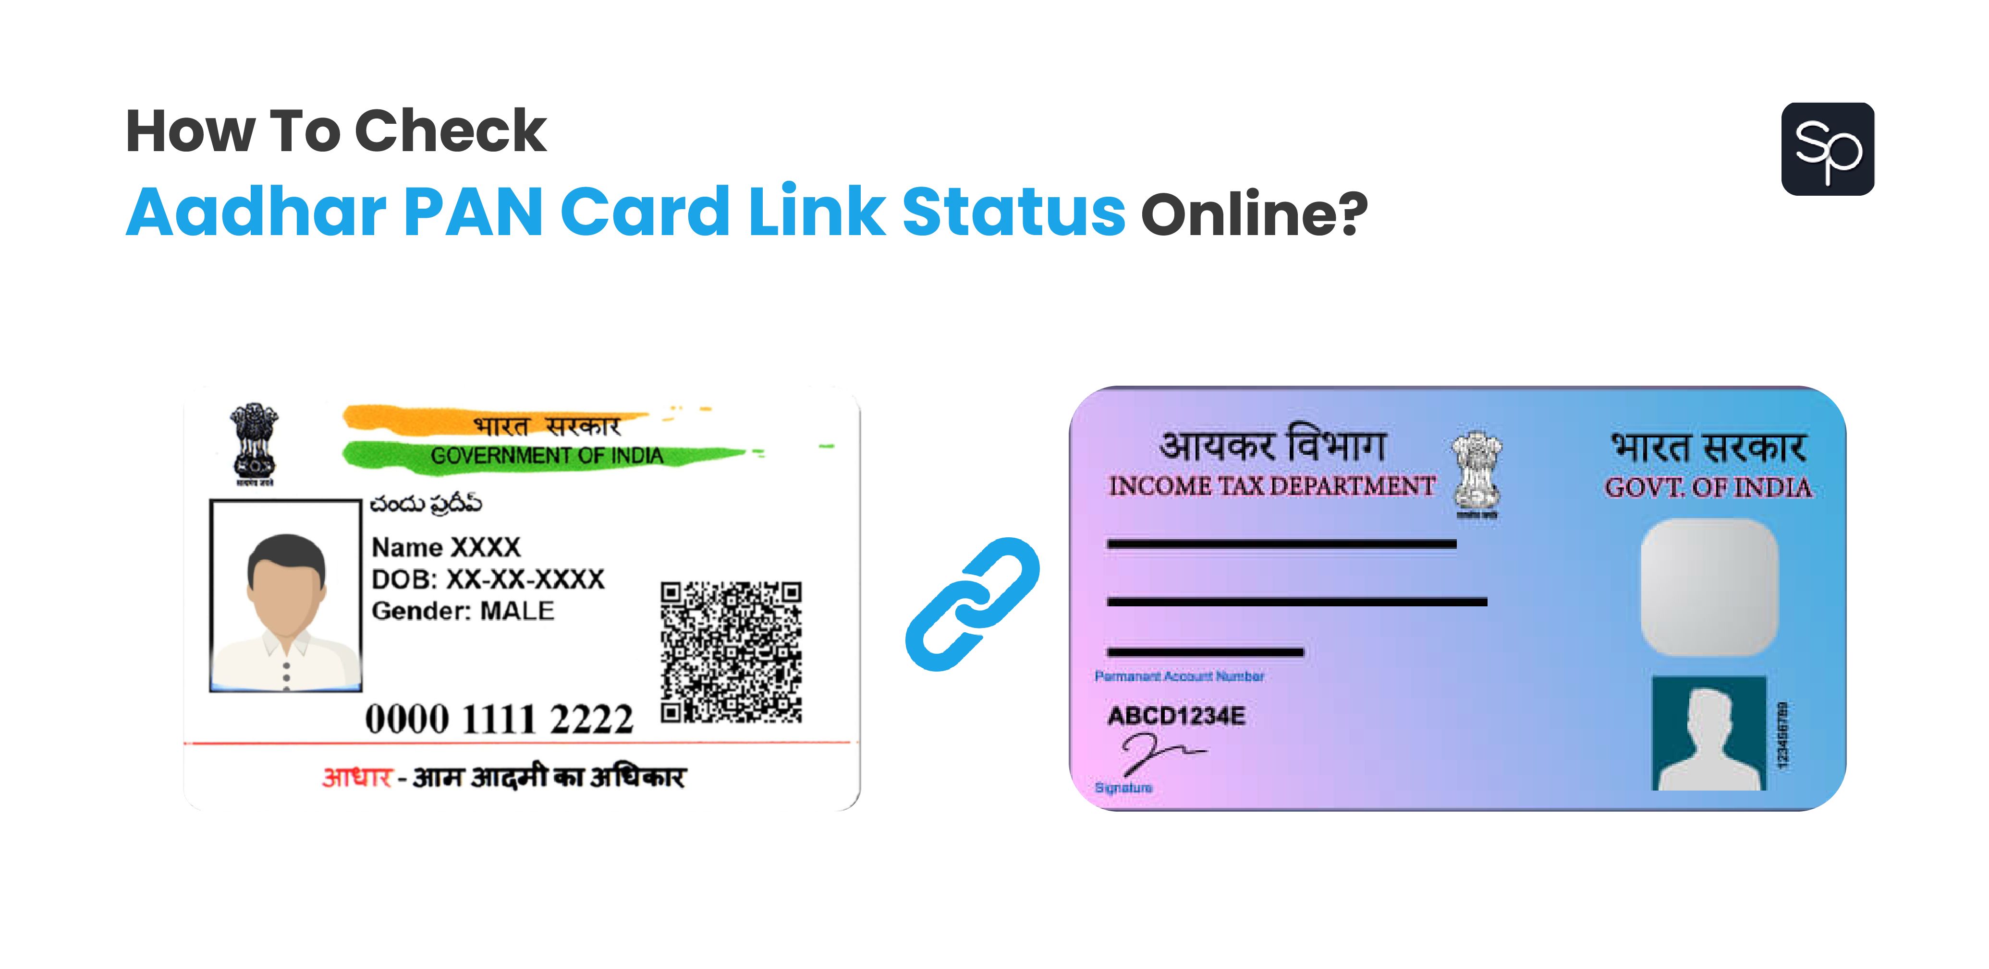

Dream Inspire Global Private Limited.
Our Product Series
Daily Need
Product
Health
Ayurveda
Product
Organic Agro Products

Slide 7

Dream Inspire Global Private Limited.
1) AYUSH APPROVED
2)
3)
Health
Ayurveda
Product

Slide 8
Dream Inspire Global Private Limited.
How to Start ?
REGISTER ONLINE
GET ID NUMBER
Buy Products
Online and offline
Passbook / Cancel
Cheque

Slide 9

Dream Inspire Global Private Limited.
Product Purchasing & ID Activation Options
7000
21,000
49,000
Individual
Business
Homeshoppi
Purchasing
Purchasing
Purchasing
1 ID
3 ID
7 ID

Slide 10
Dream Inspire Global Private Limited.
Product Purchasing & ID Activation Options
E
A
C
KIT
Select the Product
& Purchase The Product
Of Your Choice Worth 4900 BV+
B
D

Slide 11



1) Real Retail Income:-
DP & MRP
For Ex.10,000 DP Product Sell
Get 3000+ Retail Profit
30% to 50%

Slide 12

1) Real Retail Income:-
Inspire
Premium
Health Drink
Agro
Kit
MRP- 1499/-
MRP- 5499/-
DP- 999/-
DP- 3999/-
Retail - 499/-
Retail - 1499/-

Slide 13

2) Turnover Matching Income:-
Weekly Calculation
Saturday to Friday
Rs.100
Self & Team
Turnover
=
70 BV

Slide 14
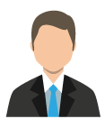
2) Turnover Matching Income:-
LEFT
RIGHT
Tuesday Payout
CASH= 7000/-
CASH= 7000/-
BV = 4900
BV = 4900
12% = 588/-

Slide 15
2) Turnover Matching Income:-
LEFT
RIGHT
10,000 BV
10,000 BV
12% = 1,200/-
50,000 BV
50,000 BV
12% = 6,000/-
1,00,000 BV
1,00,000 BV
12% = 12,000/-

Slide 16
2) Turnover Matching Income:-
Carry
Forward
System
LEFT
RIGHT
3,00,000 BV
1,00,000 BV
12% = 1,2000/-
2,00,000 BV
12% = 24,000/-
2,00,000 BV
Carry Forward BV

Slide 17
2) Turnover Matching Income:-
WEEKLY CEILING
LEFT
RIGHT
84,000/-
Income
5,00,000 BV
5,00,000 BV
12% = 60,000/-
7,00,000 BV
7,00,000 BV
12% = 84,000/-
X
10,00,000 BV
10,00,000 BV
12% = 1,20,000/-

Slide 18

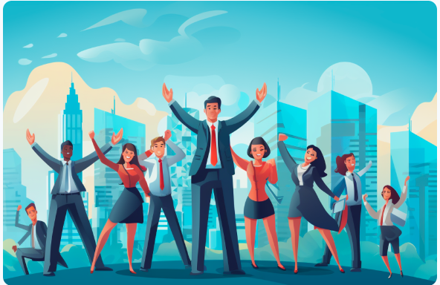
3) Sponsor Income:-
15%
Extra
Income
On
Direct Distributor
1st Purchase BV

Slide 19
3) Sponsor Income:-
BRANCH-1
LEFT
RIGHT
4900 BV
BRANCH-2
+
4900 BV
TOTAL BV
9,800 BV
CASH= 7000/-
CASH= 7000/-
BV = 4900
BV = 4900
Sponsor Income:-
15% = 1470/-

Slide 20
3) Sponsor Income:-
You Get
15%
Income
On
Direct Distributor
1st Purchase BV
LEFT
YOU
RIGHT
A
B
C
SPONSOR BY
YOU
1st PURCHASE OF
BV 10,000/-
15% = 1500/-
You Can Sponsor Unlimited Direct & Get Income

Slide 21
Multiple ID Income:-
My ID 1
24,000/-
INCOME
24,000/-
+
My ID 2
12,000/-
My ID 1
+
LEFT
RIGHT
My ID 3
12,000/-
INCOME
INCOME
12,000/-
12,000/-
TOTAL
48,000/-
My ID 2
My ID 3
84,000 X 3ID = 2,52,000/-
Weekly
Team A
Team B
Team C
Team D
X 4 Week
1 LAKH BV
1 LAKH BV
1 LAKH BV
1 LAKH BV
10,08,000/-

Slide 22
Nomination Facility:-
X
LEFT
XYZ
Person
RIGHT
FAMILY
PERSON
Team A
Team B

Slide 23
USP OF BUSINESS MODEL
TEAM TURNOVER INCOME- 12 %
SPONSOR INCOME- 15 %
TURNOVER + SPONSOR = 12 % + 15 % = 27 %
TURNOVER MATCHING INCOME- 12 %
= 588/-
LEFT
YOU
RIGHT
SPONSOR INCOME- 15 %
= 1470/-
A
B
BV = 4900
BV = 4900
TOTAL = 2058/-

Slide 24


